Slide 1
Design thinking in teaching and case studies

Slide 2
Service design approach

Slide 3
CUSTOMER JOURNEY IN FULL
Notes:
Asiakaspolku
Haastattele ja listaa asiakkaan kokemat onnistumiset, ilot ja epäonnistumiset asiakaspolussa.

Slide 4
We looked at user/customer jobs
The lane for jobs to be done (JTBD): what a particular service or product, whether physical or digital, helps the customer to achieve for specific steps of it.
Helps to move away from the current solution and create a new frame to look fo opportunities or to discover steps that do not provide value to a customer, but only exist due to the provider’s processes

Slide 5
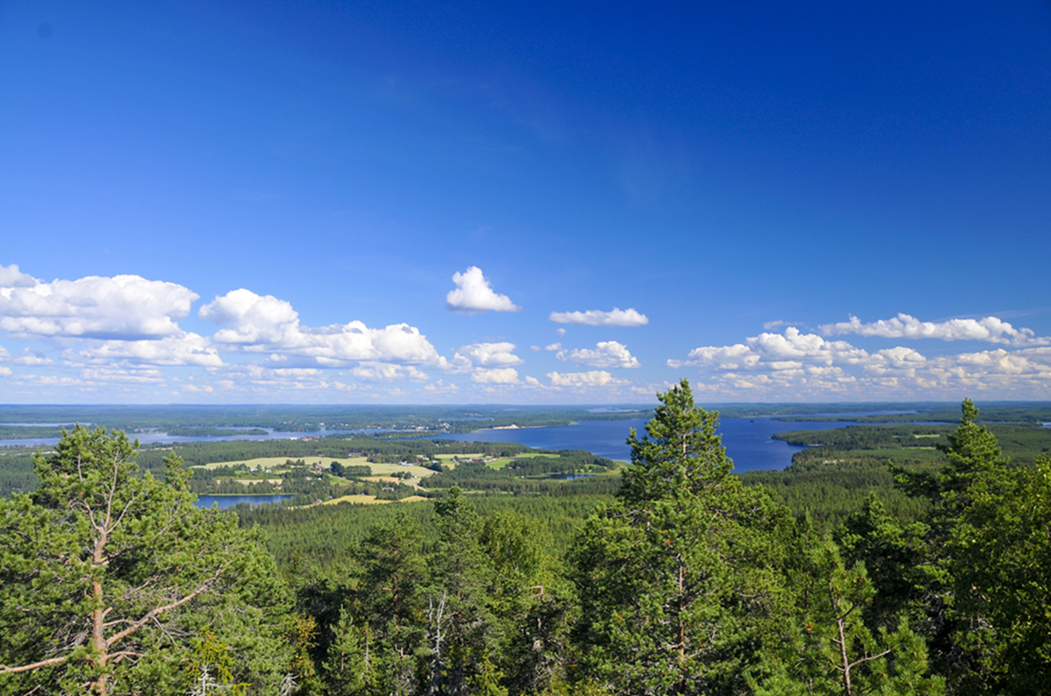
THE CASE: The brand and service strategy of Break by Sokos Hotel Vuokatti. How to make the strategy visible and part of employees’ everyday activities?

Slide 6
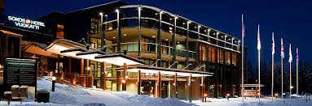
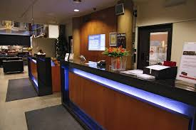
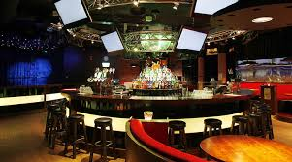
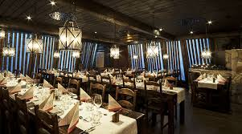

Slide 7
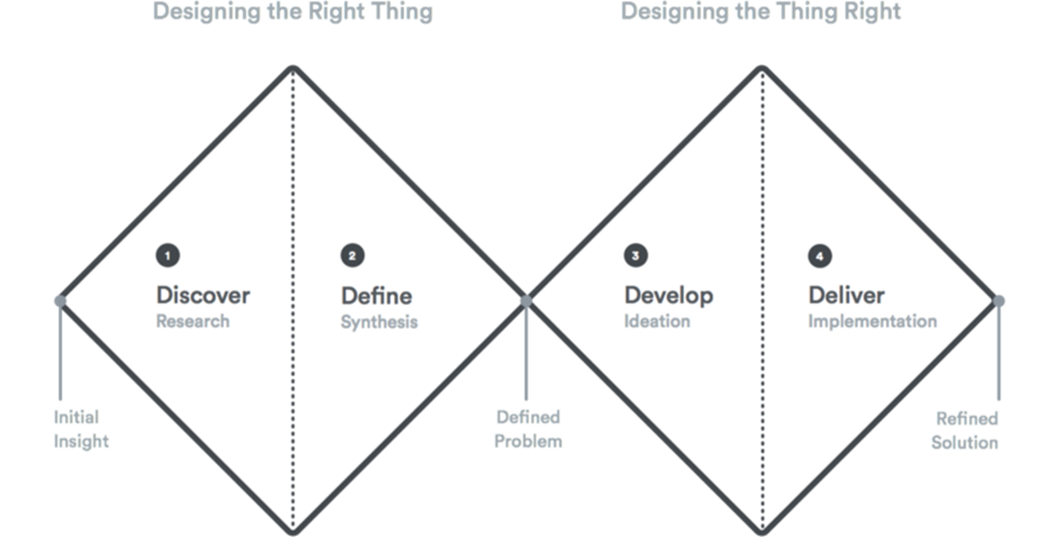
Investigating some steps of the customer journey… JOB TO BE DONE
I - DISCOVER
Tool 1) Orientation: PROBLEM – IDEATION - IMPLEMENTATION
II - DEFINE
Tool 2) Trends and insights TREND TOOL
III - DEVELOP & DELIVER
Tool 3) CREATING CUSTOMER VALUE
Backstage processes: Customer benefits
How to create customer benefits?
What if’s: What could go possibly wrong?
Helps to check if appropriate service recovery systems are in place

Slide 8
FOCUS
Experience and product-centered journey maps (user/customer jobs)
“Customer experience is a new brand”

Slide 9
”Towards the inner brand thinking.” (Malmelin & Hakala 2008)

Slide 10
”Towards more personal service culture and better customer understanding.” (Malmelin & Hakala 2008)

Slide 11
Workshop I (4 hours)
Introduction (10 min)
About branding (10 min)
Orientation task (30 min)
Trend Analysis task ( 1 h 15 min)
Break 20 min
Acknowledging the customer value (1 h 15 min)
Wrapping it up (20 min)

Slide 12
Brand is directing the organisation, its activities as well as communication.
→ All the hotel activities becoming part of creating a cohesive and joint brand experience.
What does it mean for the staff to be involved?
What is the main goal of the hotel brand activities?
In practise – in what ways the goals are reached?

Slide 13
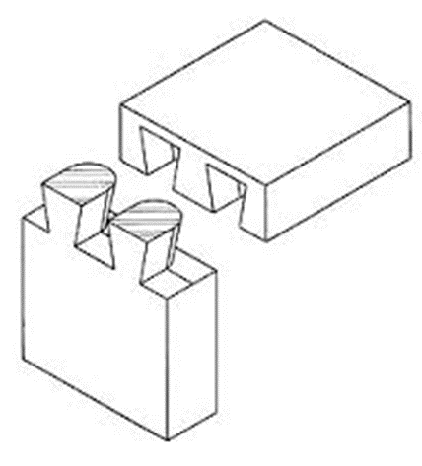
UNDERSTANDING THE GAP:CURRENT STATE VS. FUTURE STATE Planned and existing brand and service strategy versus the everyday work of service personnel

Slide 14
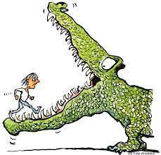
The challenge…
A) Understanding Break by Sokos Hotel Vuokatti’s brand and service strategy. How to make implement it is everyday customer service?
B) How to make the strategy visible for the customers?

Slide 15
TOOL 1) The problem phase
Orientation to the topic
1. What is the most interesting thing in your customer service work?
2. Where do you think your team is succeeding the best?
TASK: Thinking about the drawbacks of the current customer service.
WRITE THE IDEAS TO RED STICKY NOTES
THE NOTES ARE COLLECTED AND CATEGORISED
ALL THE PARTICIPANTS HAVE THREE VOTES WITH WHICH THE IMPORTANCE OF THE PROBLEM CAN BE HIGHLIGHTED

Slide 16
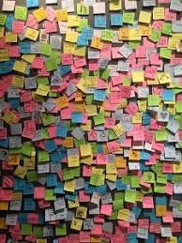
2. The ideation phase
Looking at the challenges together.
TASK: Try to find solutions to the main problems.
WRITE THESE IDEAS TO THE GREEN STICKY NOTES
THE NOTES ARE COLLECTED AND CATEGORISED

Slide 17
3. Implementation phase
Easy to put into practise
Hard to accomplish
Small effect
Big effect
Notes:
Tulosta A kolme ja teippaa fläpille

Slide 18
TOOL 2) TREND-tool
Recognising the trends that your hotel will create in the future.
To what signals the trend is based on?
What effects the trend is bringing along?
How are they affecting to the overall customer experience in the hotel?
By describing the trends and brand values it provides a possiblity to reflect how they will have an effect on
the service environment
the behavior of the personnel
putting branding strategy into the everyday service offering

Slide 19
Recognize the trends that will have an effect on your hotel brand.
THE CUSTOMER EXPERIENCE
What new expectations and customer needs the trend is creating?
On what SIGNALS the trend is based?
Miten henkilöstö voi konkreettisesti huomioida nämä oivallukset jokapäiväisessä palvelutyössään?
IMPACTS ON THE HOTEL BRAND. What does the trend is bringing along?
INNOVATIVE IDEAS
How the personnel can take these into account in everyday work?
Ideas about how to brand is implemented into the service environment.

Slide 20
Making the brand and service strategy of Break by Sokos Hotel visual and concrete in the eyes of the customers
The goal: to develop the inner processes of the organisation.
Notes:
Mitä arvoa tuotamme asiakkaillemme?
Mitä konkreettista hyötyä meistä on asiakkaillemme?
Minkä asiakkaan tarpeen tyydytämme?
Millaisia kokemuksia haluamme luoda asiakkaillemme?

Slide 21
TOOL 3) THE CUSTOMER VALUE: How can the personnel fulfill the needs of the customers?
What kind of products and services will fulfill the needs of the customer?
Benefits – how the benefits are created for the customer
Worries – how to get rid of the customer worries?
Notes:
Mitä arvoa työntekijä voi tuottaa jaottelemalla asiakastarpeet tehtäviin, hyötyihin ja murheisiin.
Ohjaa miettimään oikeasti mitä arvoa organisaatio tuottaa.
verrataan olemassa olevaan asiakasymmärrystietoon
Ongelmakeskeinen lähestymistapa:
Mikä on vialla?
Mikä ei toimi?
Miten ongelmat korjataan?
Arvostava lähestymistapa:
Mikä toimii hyvin?
Millaisia olemme parhaimmillamme?
Huippuhetket, parhaat käytännöt.

Slide 22
Tasks
Benefits
How to create customer benefits?
Products and services
Worries/What if’s
How to remove the worries/what if’s?
Notes:
Asiakasarvo
Tunnista, mitä arvoa voit tuottaa jaottelemalla asiakastarpeet tehtäviin, hyötyihin ja murheisiin.

Slide 23
Second workshop Digital services and brand presence in social media channels
It is far better to adapt the technology to the user than to force the user to adapt to the technology
J.Carroll

Slide 24
Map for existing channels and current presence / wanted brand presence in digital medias
Customer service
Website
Online store
Staff
Blogs
E-ails
Brochures
Key account programs
Content marketing
Content marketing
Branded content
Product placement
SEM
OWNED
Social media
Forums
Delivery
Brand ambassadors
Testimonials
Reviews
Consumer generated content
TV
Printed ads
Display
Video ads
Outdoor ads
Sponsored content
BOUGHT
EARNED
PARTNERS
Affiliate marketing
Partner marketing
Shop-in-shop
Trade places
Content co-operation
Added services
Notes:
Kanavat
Tunnista, miten eri asiakasprofiilit käyttävät eri kanavia asiakaspolun eri vaiheissa.

Slide 25
Main message
Channel
Notes:
Sisällöt ja palvelut eri kanavissa
Pohdi, missä kanavissa eri sisältöjä ja palveluita voidaan hyödyntää.

Slide 26
Case: city of kajaani
Notes:
”Nykymaailmassa paikat kilpailevat enenevässä määrin toisiaan vastaan.”
”Kaupungit, kunnat, seudut ja alueet kilpailevat yhä kiivaammin asukkaista, osaavasta työvoimasta, yrityksistä, investoinneista, pääomista, opiskelijoista, matkailijoista ja tapahtumista.”
”Kyse on eräänlaisesta ’paikkojen sodasta’ , jossa paikkojen edistäminen tai uudelleenrakentaminen (tilan tuottaminen) on oleellinen osa menestymisen politiikkaa.”

Slide 27
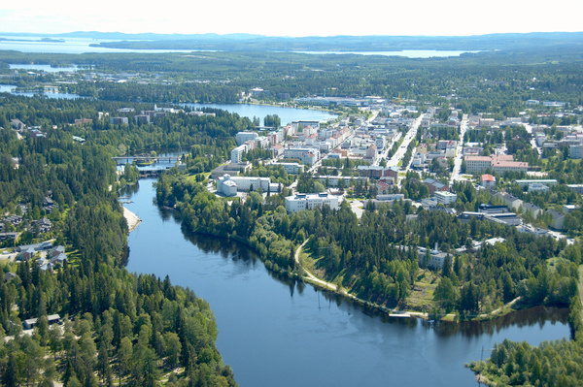
Background of the case

Slide 28
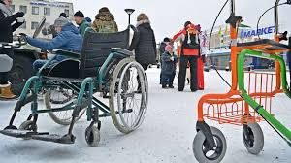
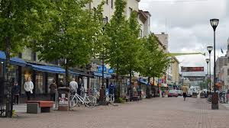
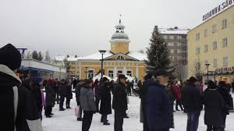
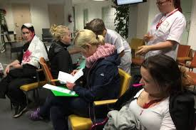
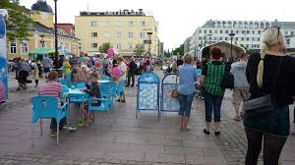
”Cities aren’t structures, cities are people”
Edvard Glaser

Slide 29
First workshop
Approx. 22 key persons of the city communications from different branches
The aim was to find out their opinions about
urrent state of the communication,
Their target image for the city
Their future vision about the brand, that will support the strategic objective
Information gathering were done in three work sessions

Slide 30
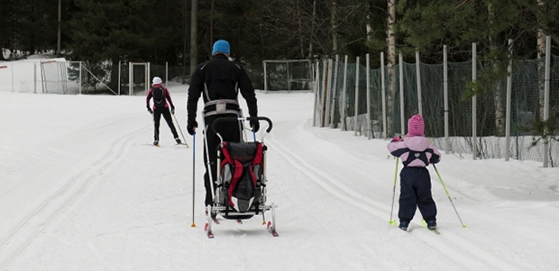
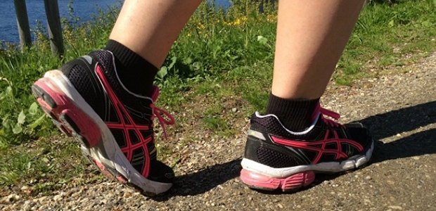
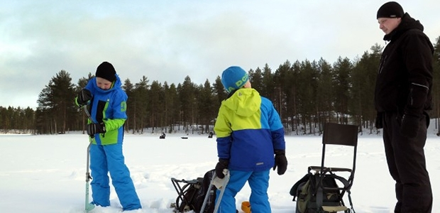
The starting point: City strategy
The City of Kajaani wishes to boost corporate growth, create opportunities for viable business transactions and to achieve the growth objectives set in the urban strategy. It is the centre and capital of the Kainuu region and in many senses its engine.
The main objective for the city strategy 2015 - 2018 is to build Kajaani to a growth center; a year 2025 Kajaani should be at the forefront of growth.

Slide 31
Task 1. 5 minutes for each
Information gathering
A play with Post-its
An idea generation -> most appealing and attracting factors of the city
Use of Post-It notes for marking most important target groups and relevant stakeholders for brand communications
One note for each, 5 minutes time, aim to have ideas as much as possible

Slide 32
Classification of the post-it notes

Slide 33
Task 2. Brand mESSAGE
Analysing strategic objectives and how communications is supporting these.
A play with a pen and paper
Name at least three things, how communications is supporting now strategic objectives and how it should support in future .
5minutes.
Write down a main message for the city communications. Name a responsible party for the communications and tone of voice.
10 min.
Reflect how stakeholders should be part of the communications, how to build a dialogue and how to participate them to strategic objectives? 10 min.

Slide 34
Task 3. Future image
In the discussion groups following questions were asked and answers were collected:
How different strakeholders can support the strategic objectives and brand messages?
How city of Kajaani can support active dialogue witn and between different stakeholders?
How brand communications should be organised in order to support strategic objectives.
Future recommendations
Notes:
Muodostetaan pienet keskusteluryhmät ja saavat 5 min aikaa kirjata yhdessä eri näkökulmia
Mitkä bränditekijät ovat kaikkein merkityksellisimpiä? Mitkä tekijät vaikuttavat mihinkin sidosryhmään? Mitä kukin sidosryhmä arvostaa?

Slide 35
Second workshop
With the stakeholders from 12 different organizations; including versatile range of professionals and companies as well as different interest groups and NGO´s.
Materials from the first workshop were classified, analyzed and argued.
Based on the results introduction and orientation was created

Slide 36
Lotus Blossom -model
8*8 Lotus Blossom model for creating new ideas
The basis was the city strategy:
Kainuu – at the forefront of growth
In the middle: the main focus
From the big picture to concrete action:
The objective is to find factors from stakeholders view that can lead to the vision: to be at the forefront of growth

Slide 37
Notes:
Idean keskipisteellä tarkoitetaan brändiin vaikuttavia tekijöitä, joilla saadaan toteutumaan strateginen tavoite: Kajaani kasvun kärjessä
Työskennelkää pareittain

Slide 38
Lets try!
Lotus Blossom in action

Slide 39
Hands on – how can you use these tools in your teaching / job?
For teachers
Take a first A3-canvas and write in the middle one of your basic courses or equal, that you would like to improve or try designing tools
For staff
Take a first A3-canvas and write in the middle the core thing you would like to improve (the problem or the issue e.g. how to attract new students/enhance the exchange abroad etc.?)

Slide 40
Hands on – how can you use design tools in your teaching / job?
For teachers
In the first surrounding boxes write important elements that are connected with the chosen main focus e.g. which tools you could use, different approaches to the pedagogy, course main topics
For staff
Write in the first surrounding boxes important elements connected with the chosen main focus
In the second surrounding boxes – specific features concrete examples
Notes:
In the first surrounding boxes important elements connected with the chosen main focus

Slide 41
Peer evaluation | Self assessment | Written exam | Target groups | Partner company | Critical points |  | Triggers | Theoretical approach
Learning diary | Assessment criteria's | Case presentation | Contact points | CASE study | Public / private company |  | PBL | Problem to be investigated
etc.-. | Articles | Book summaries | Development task
Role play |  |  | Assesment criteria's | CASE study | Problem based learning |  | Phenomenon | Key Concepts
Virtual environment | Gaming |  | Gaming | Course x. | Lotus Blossom |  | Lotus Blossom
 |  |  | Coaching/facilitating | Innovative solutions | x.
Coach sessions |  |  | Virtual environment | Story telling | Social media channels
 | Coaching/facilitating |  |  | Innovative pedagogy | Flipped classroom |  | x.
Notes:
In the first surrounding boxes important elements connected with the chosen main focus
In the second surrounding boxes – specific features concrete examples

